Slide 1

Mini-Project : EDA & STATS
TITLE :-
EXTRACTING REQIURED DATA FROM DATASET
USING EDA AND VALUES USING STATS
Submitted by :-
VIVEK
VARDHAAN
DHARMA
SUDHANSU

Slide 2

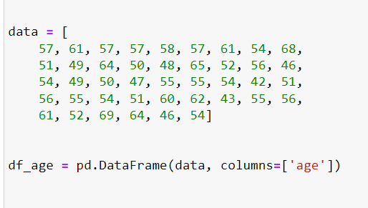
Data Set Description(Part-1)
USING AN AGE DATAFRAME EXTRACTING DIFFERENT DATA REQUIRED TO US

Slide 3

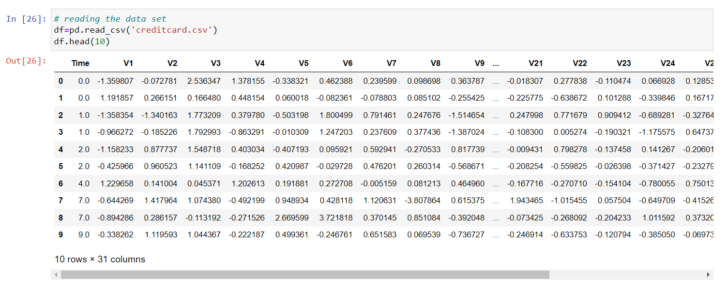
Data Set Description(Part-2)
Using a dataset of Credit Card Transaction performing different value extraction operations

Slide 4
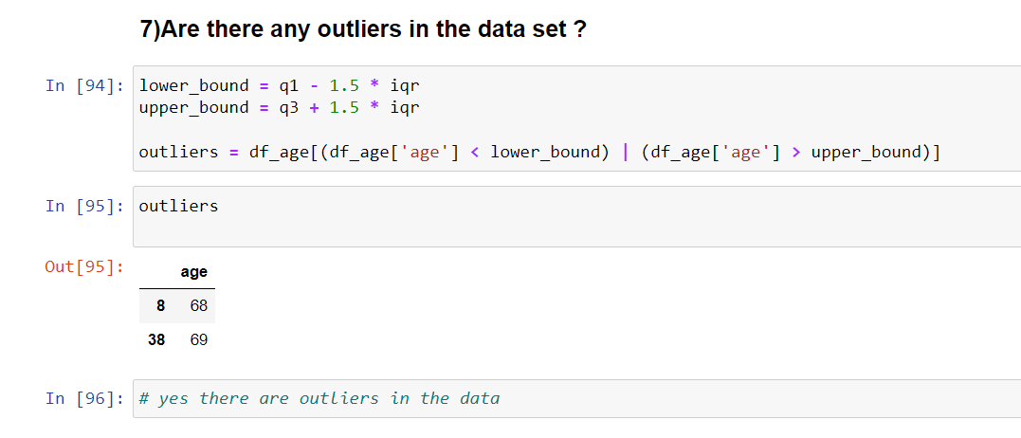


Slide 5


Slide 6

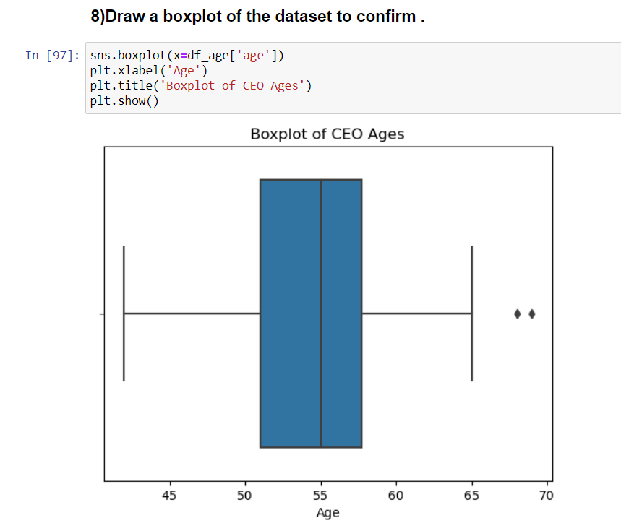

Slide 7
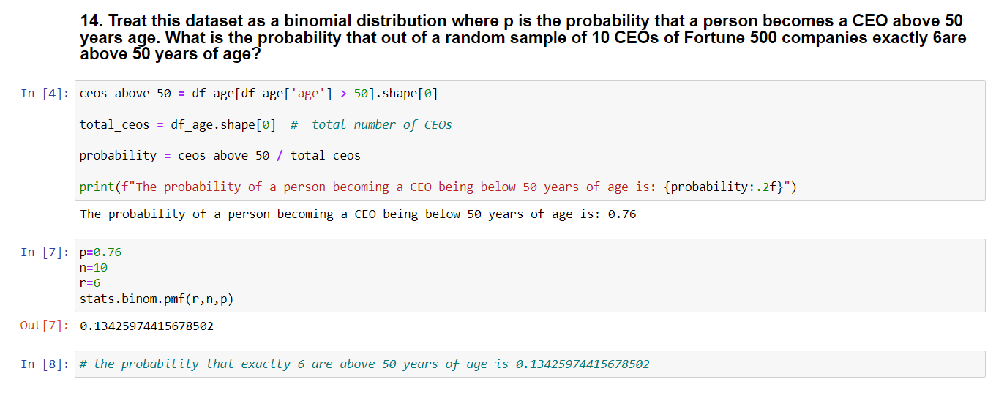

Slide 8

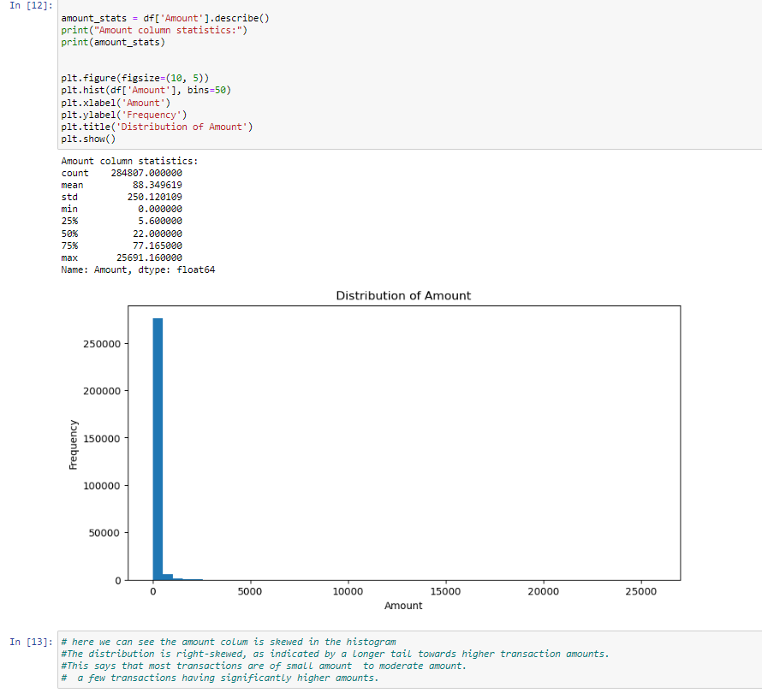
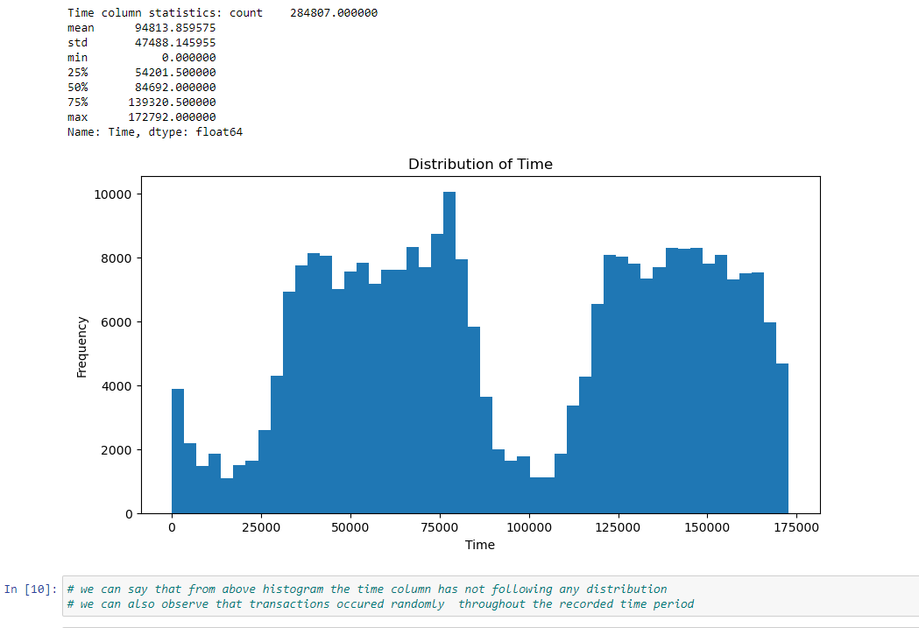

Slide 9
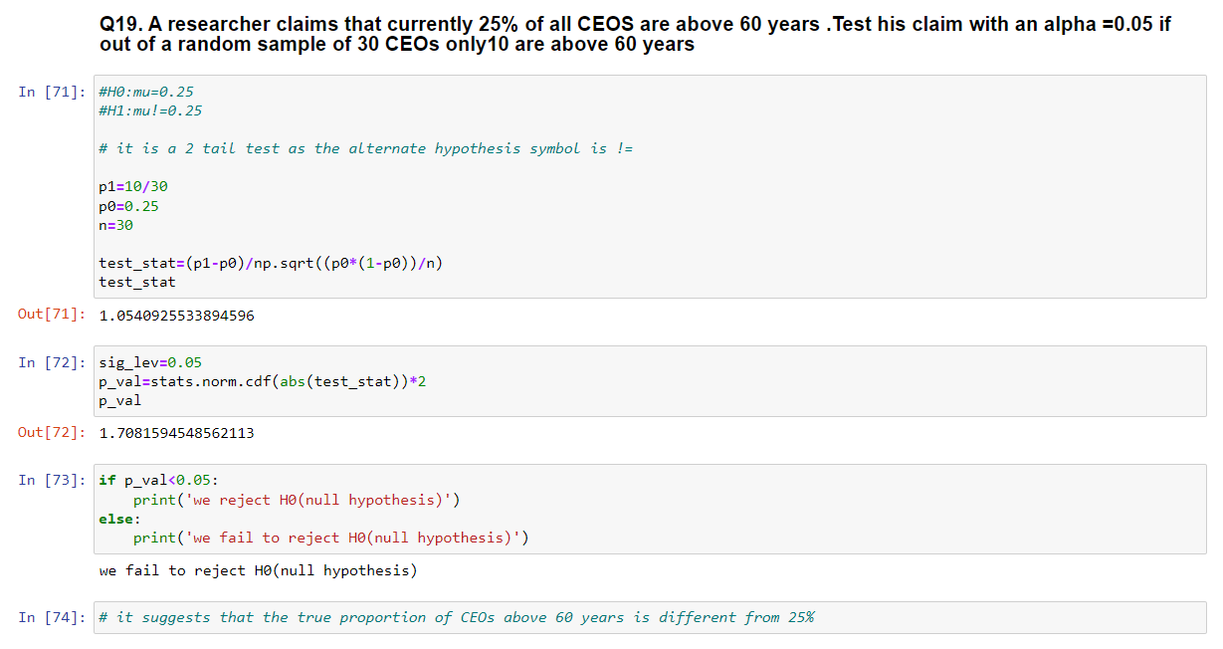

Slide 10
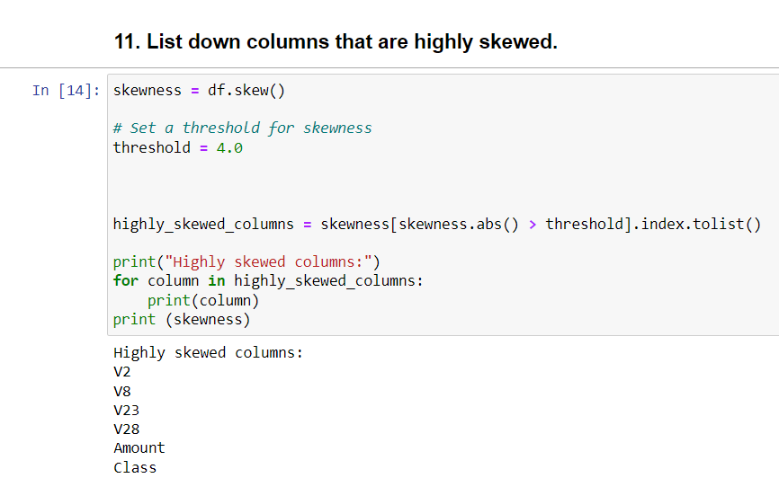
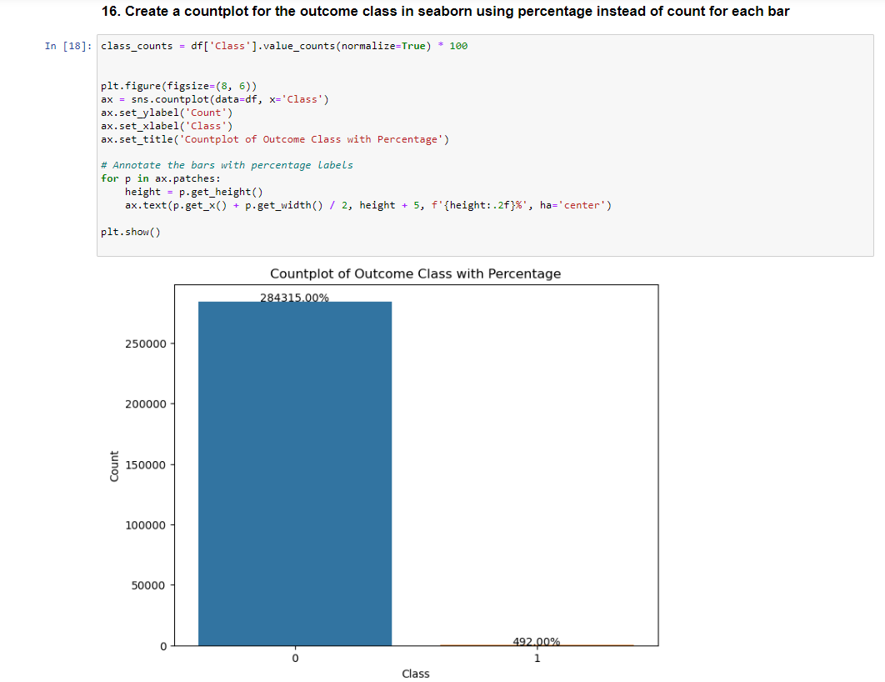


Slide 11
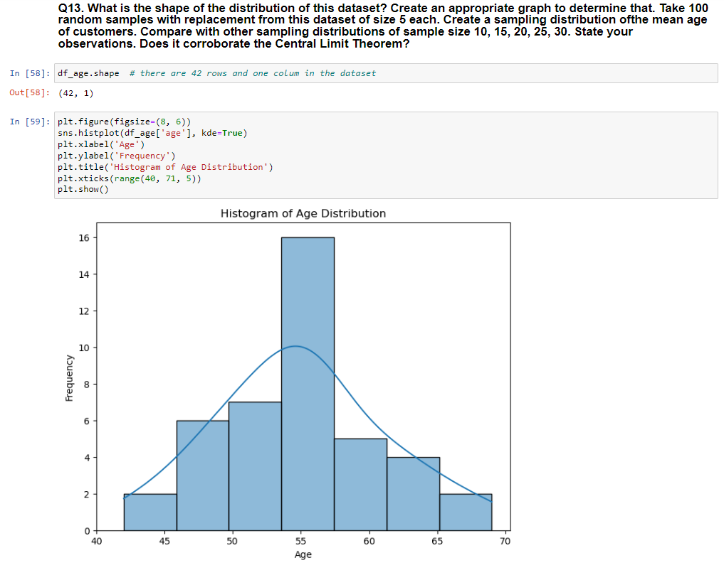
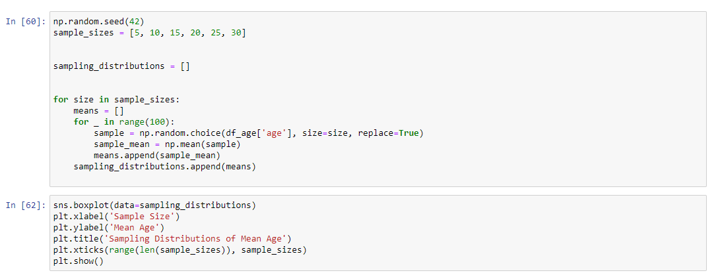

Slide 12
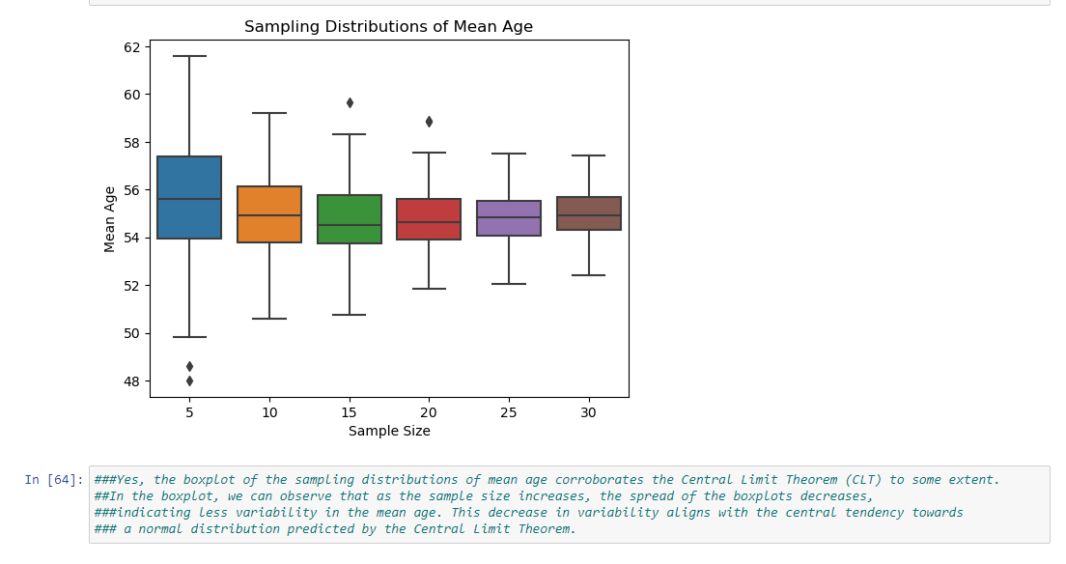
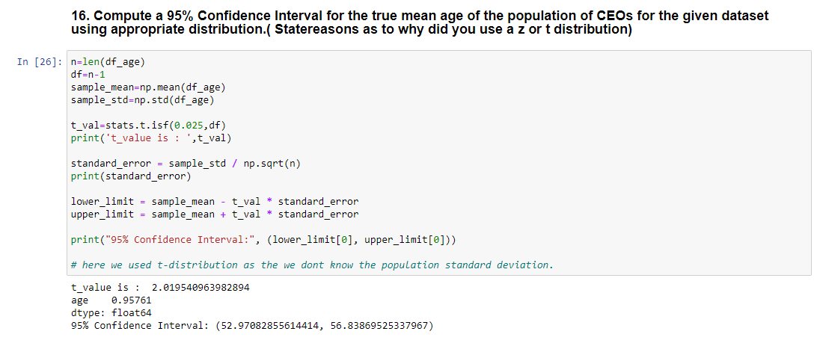

Slide 13
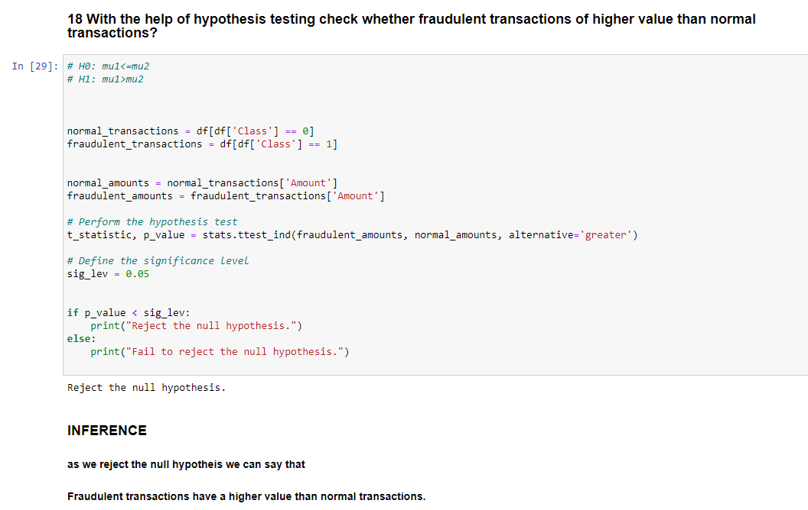
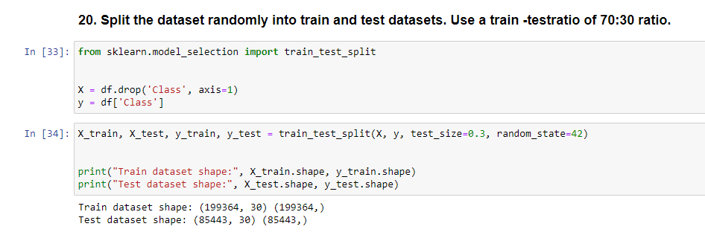

Slide 14
Thank You !!!....

